Slide 1
Unit 5 Assignment 1
Tom Hutchings
Notes:
Intro
In this presentation I will outline networking technologies, tools, management and emerging technologies in the computing world.
I will also talk some about fault management, and how to maintain networks.

Slide 2
Network Technologies P1
Operating Systems, Protocols, Network Layouts and Network Devices

Slide 3
Operating Systems
An operating system, abbreviated to OS, is the lowest level of software running on a computer.
It handles Input and Output with the hard drive and peripheral devices, drawing to the screen and running of software on the computer.
An OS also handles network functions at low and high levels.

Slide 4
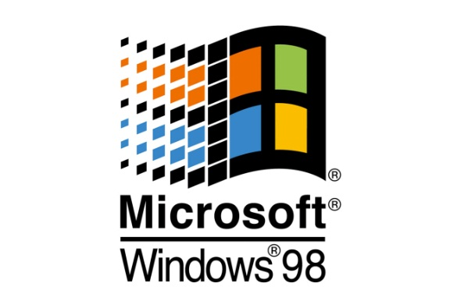
Microsoft Windows
Arguably the most well known and common OS, Windows 1.0, the first version of windows, was developed by Microsoft and released in 1985.
Primarily used on home computers and workstations, although a server version is available.
While originally windows used Microsoft DOS as a base, it is now based off its own NT kernel.

Slide 5

Apple OSX
OSX was first released in 2001.
OSX is used only for personal computing or workstations.
Normally only available for Apples own computers, although it has been successfully installed on others.
Based off a fork of the BSD kernel called Darwin, also integrating some components of the NeXTSTEP OS.

Slide 6

GNU/Linux
Linux is a kernel written by Linux Torvalds in 1991 while he was at University.
He found it worked with the GNU projects free software, leading to developers integrating GNU software with the kernel.
Largest installed base of all OS’s.
GNU/Linux is used in the IT industry for servers, network devices like routers, and workstations.
Notes:
When Linus first posted on UseNet about his development of a new Unix-like kernel, he said
“I'm doing a (free) operating system (just a hobby, won't be big and professional like gnu) “
Twenty years on and Linux, along with GNU’s user space software, is the most installed OS in the world.
While the personal use market share for linux is small, the Android mobile OS uses the Linux kernel. Because of Android’s popularity and Linux’s use on servers, it holds the title of largest installed base of all common operating systems.
Linux is licensed with the GPLv2 license, and most GNU software is GPLv3 or 2, allowing it to be shared freely and without restriction or cost.

Slide 7
Network Protocols
A network protocol defines how network devices communicate.
Different protocols are suited to different purposes, eg. FTP is for transferring files, HTTP websites.
Protocols are assigned a ‘port’ that is used in filtering and routing packets.
Protocols can be grouped into stacks or suites, where multiple modular protocols are required, or just work better together.

Slide 8
FTP – File Transfer Protocol
FTP is a protocol that allows transfer of files across networks.
The first FTP specification was written in 1971 and predated TCP/IP.
On the Server FTP uses port 21 as a command port and 20 as a data port, but the client chooses a random port for outgoing and incoming connections.

Slide 9
HTTP/HTTPS – Hyper Text Transfer Protocol
HTTP is a protocol used for transferring webpages, consisting of HTML, CSS and JavaScript.
HTTPS is HTTP Secure, using TLS or SSL to encrypt transferred data. As HTTPS uses host authentication, it is required that the server has https set up beforehand.
HTTP uses port 80 and HTTPS uses port 443.
Notes:
HTTP was partly designed to replace FTP for small file transfers like webpages, as FTP had many bugs and design issues which made it impractical.

Slide 10
SSH – Secure Shell
SSH is an encrypted protocol that allows logging in to computers remotely.
SSH can also be used to encrypt any network traffic.
SSH uses port 22 by default.
Notes:
Was designed to replace the outdated and insecure telnet protocol.
While it is usually used to execute commands remotely, you can also use SSH to tunnel X server connections for remote GUI use, use scp for file transfers over SSH, as a full fledged VPN and many others

Slide 11
ICMP – Internet Control Message Protocol
ICMP is a protocol used for network diagnostics and error reporting.
ICMP is not usually used to transmit data like TCP and UDP do, but instead to send simple messages.
ICMP can send lots of different messages using type and code sections of the header.
Does not have a port.
Notes:
ICMP does not have a port as it is not an OSI application layer protocol.

Slide 12
Network Layouts
Notes:
Here I will show some network layouts, or topology’s. These constitute how nodes are interconnected in a network, with varying suitability for different applications.

Slide 13
Point To Point
In a point to point network just 2 nodes are connected by a single connection.
While useful when only two devices need to be connected, Point to Point is useless when more devices need connections.

Slide 14
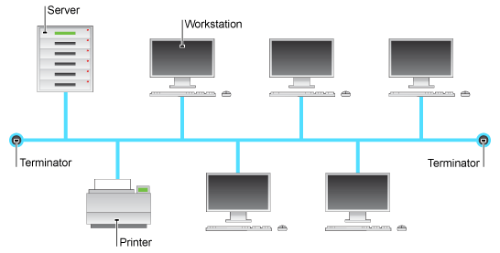
Bus Topology
In a bus network all devices are connected by a single cable.
Central cable is known as a bus.
Easy and cheap to implement.
Single point of failure.
Notes:
Nodes broadcast a packet in both directions, where it travels along until it is received by the intended node.
Each node in the network checks the destination address and ignores it if it doesn’t match its own.
If the address matches its own, the data is accepted and processed.
While easy to implement and easy to add nodes to, the single bus cable gives a single point of failure.

Slide 15
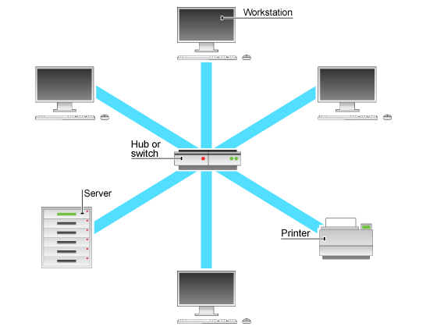
Star Network
All nodes are connect via a central node
Simple to implement
Easy to add nodes
Single point of failure
Notes:
In a star network all network devices are connected to a central node with a point to point connection
All devices are therefore connected to each other via this central node.
A star network is easy to implement, and easy to add nodes to as well.
The star topology, however, has a single point of failure in the center node.

Slide 16
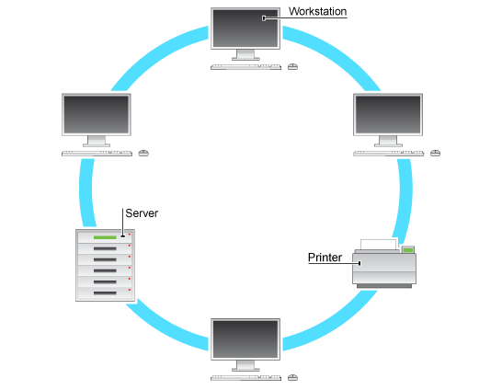
Ring Network
Each node is connected to two others in such a way that a loop is formed.
Packets travel around a ring in one direction.
Each node is a point of failure
Notes:
In a ring network each node is connected to two others. No end nodes are present, as each is connected to two, so that a ring is formed.
Packets within a ring network travel in one direction,

Slide 17
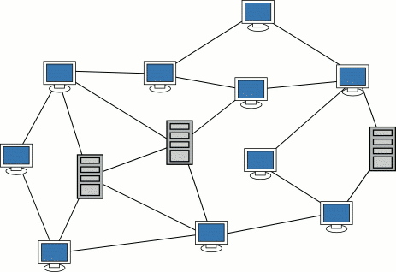
Mesh Network
Mesh networks are a subcategory of networks where each node acts as a relay as data travels along.
Mesh networks can be flooding or routing.
Mesh networks are ideal for so called ad-hoc networks.
Notes:
A Flooding network’s nodes broadcast received data to all connected nodes. Flooding is simple and reliable, and no advanced routing algorithms, techniques, or software is required.
Routing network node’s use path finding and continuous connections to route data.
Routing networks must self heal broken paths when nodes break or become unreliable.
Ideal for ad-hoc networks due to their self-healing properties.

Slide 18
Network Devices
Notes:
Various devices on a network can send, receive, route, filter, monitor and modify packets and data.

Slide 19
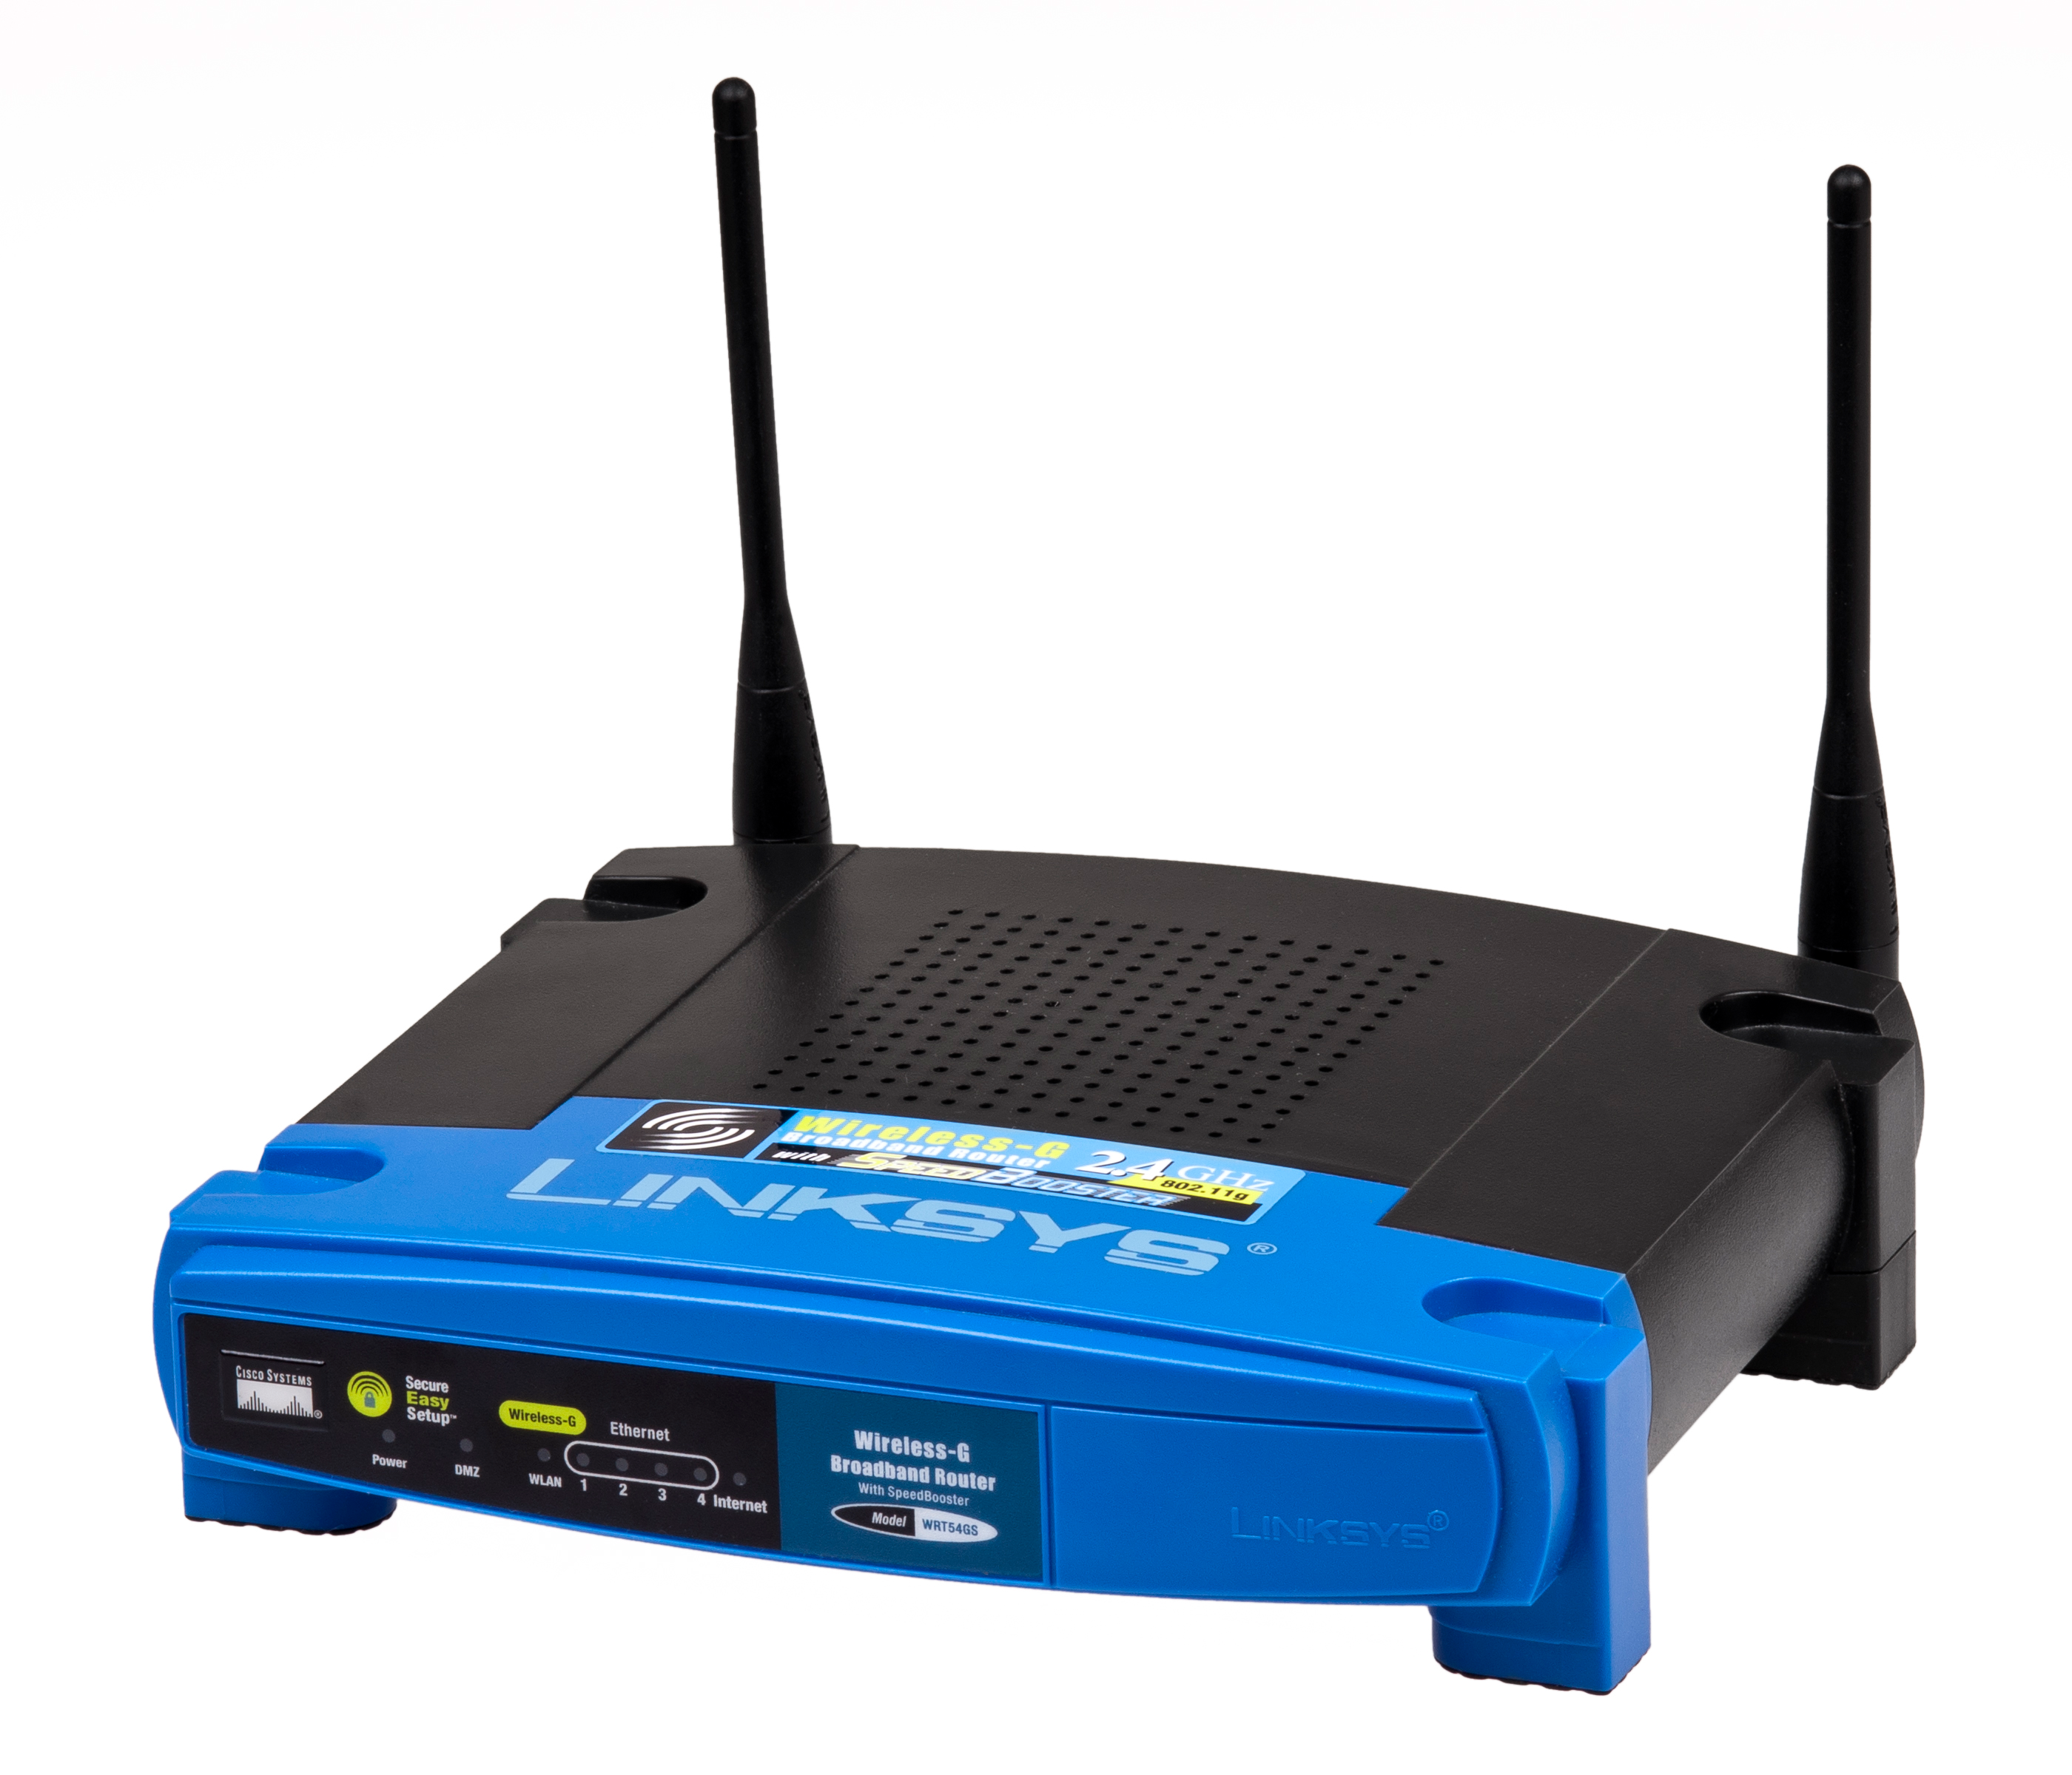
Router
Routes packets between networks.
Comes in small, consumer size and larger, corporate sized units.
Routers are commonly used for connecting to the internet
Notes:
A router is a device that directs packets between networks.
Routers are commonly used in households to connect to the internet, via an ISP (Internet Service Provider).

Slide 20

Switch
Connects devices on a network.
A switch sends packets over a local network.
Varying OSI layer depending on switch type.
Managed or Unmanaged.
Notes:
A switch connects nodes over a network using packet switching technology.
Some switches operate at multiple levels of the OSI model. These are known as multilayer switches.
Most switches operate on layer 1, acting as simple hubs.
Switches on layer 2 act as bridges, ‘bridging’ small networks together.
An unmanaged switch is simple and plug and play.
Managed switches have the ability to be configured via a serial cable, telnet or SSH (Secure Shell).

Slide 21
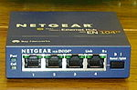
Hub
Used as the central node in the star topology.
Operate in layer 1 (Physical).
Very simple design.
Notes:
Hubs are simple devices used in the center of a star topology network.
Hubs operate in the physical layer of the OSI model.
Hubs are simple and they echo all incoming packets to all ports, a very insecure practice. Hence they are only really useful for small networks where security is not an issue.

Slide 22
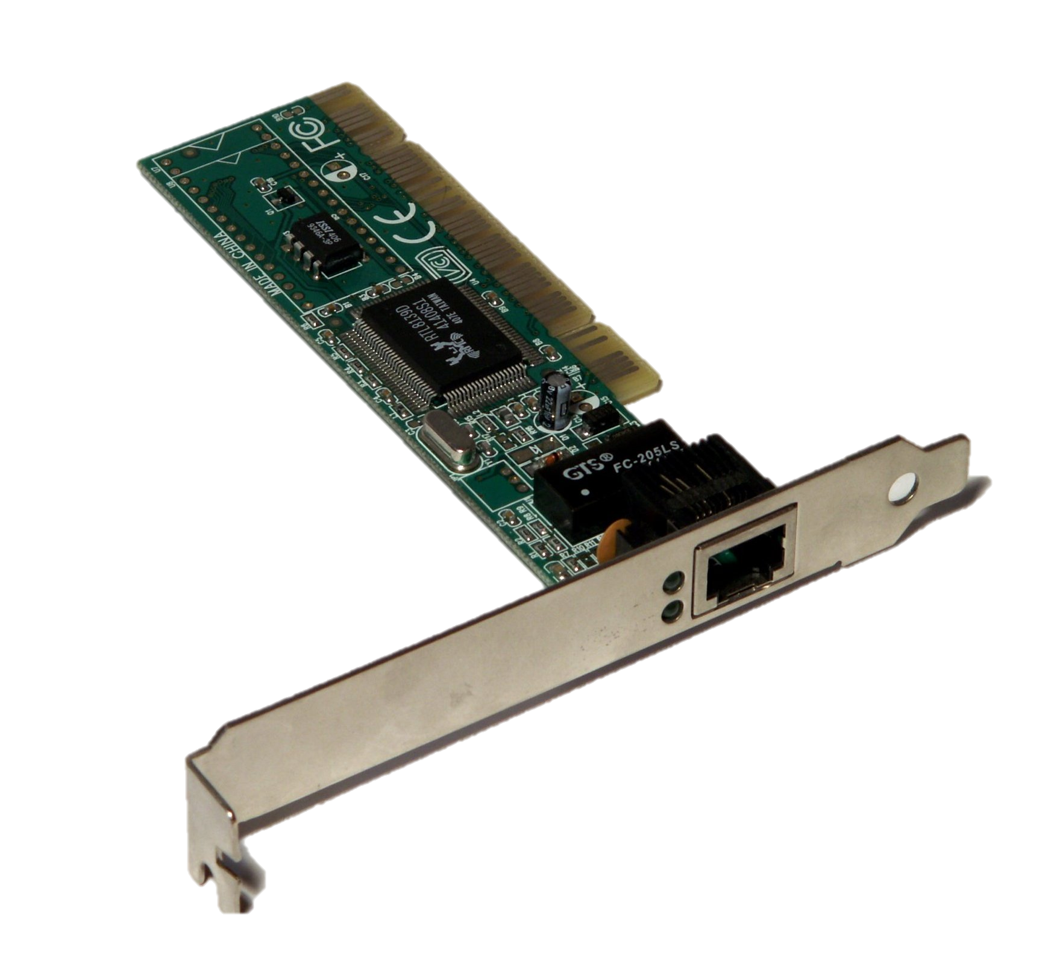
Modem
Modems allow data to be sent over a phone line.
Modulate data into sounds.
Demodulate sounds to data.
Notes:
Modems allow normal internet traffic to be sent over a phone line.
Modems will modulate data into sounds to be sent over a phone line.
Modems also demodulate sounds into data to be used over a network.
Hence the name Modulator-Demodulator.

Slide 23
Wireless Access Point
Allows wireless devices to connect using a standard like Wi-Fi.
Typically several WAP are connected to a wired LAN.
Devices like Phones and Laptops are normally Wi-Fi enabled.
Often used for quick connect ‘hotspots’.
Notes:
As many devices use Wi-Fi, WAP’s are useful for so called hotspot network, which provide internet in places like coffee shops or restaurants where users may connect for brief periods for under about 2 hours, maybe with a web interface to manage login and payment.

Slide 24
Purposes of Networking Tools – P2
Network Tools, Fault Management, Performance Management and using system software to find network assets.
Notes:
In this section I will go through some of the tools used in networking, fault and performance management of networks and how to use system software to find network assets.

Slide 25

Nmap
Nmap is a tool for mapping networks.
Originally written in 1997 by Gordon Lyon.
Used for detecting hosts on a network.
Can scan hosts for open ports.
Can use NetBIOS scanning to find names of computers.
Notes:
Nmap is a tool for scanning and mapping networks. It was originally written by Gordon Lyon, known by his pseudonym of Fyodor Vaskovich), in 1997 as an article in the online hacking magazine Phrack, with complete source code.
Nmap scans over an IP range, pinging each target and waiting for a response, then compiling a list of all running hosts or devices.
Nmap can scan in a silent and visible modes, silent mode giving the ability to scan a network without being detected.
Aside from regular IP mapping Nmap can scan hosts for open ports, which may be vulnerable to attack.
Nmap is a rather controversial tool. Nmap’s wide range of features and wide availability lead to it being used maliciously by ‘hackers’.
Nmap is also freely available and licensed under a free software license, specifically the GNU GPL. This means it is very easily obtainable and legally allowed to be spread around via third party websites or physical media.

Slide 26

Wireshark
Wireshark is a packet sniffing program
Written in 1998 by Gerald Combs.
Used for network troubleshooting and protocol analysis
Features a GUI.
Notes:
Wireshark is a packet sniffing and analysis program used for monitoring packet traffic on a network, and analyzing those packets.
Wireshark was written in 1998 by Gerald Combs, a Computer Science Graduate, while he was working at a small ISP. All commercial packet analyzers at the time did not run on the ISP’s primary Operating Systems, and were considered too expensive. Gerald wrote Wireshark, then called Ethereal, and later was hired by a company who started development on Wireshark. Gerald moved the Ethereal code, which he owned, over to Wireshark and abandoned ethereal.
Wireshark intercepts and records packets on a network. Wireshark can break up packets into human readable fields for packet analysis. The Wireshark GUI assists in packet analysis by visualizing packet contents.

Slide 27
Fault Management
Software or functions that detect errors or malfunctions in a network
Maintain error logs
Adjust for changes in environment that may alter the speed or reliability of a network
Notify administrators when errors appear that require further repair than the system can provide
May be active or Passive
Notes:
A fault management system detects and handles faults in a network. These systems also adjust for changes in a networks environment, scan for threats such as viruses, and alert administrators of errors.
Fault management systems can be any tools or specific procedures for detecting and managing errors.
A fault management system may also maintain and store error logs.
Fault detection systems may be active or passive.
A passive system requires individual devices to transmit error messages or alarms when they detect their own errors. While this mode allows for a simpler method of monitoring, where a system just waits to receive error messages, if a device loses the ability to transmit an alarm then the Fault Management system will not become aware of the error, and will not alert an administrator.
An active system will periodically ping all of the devices it knows about, checking whether they are online and functioning correctly. If a pinged device does not respond then the system will sound an alarm and alert an administrator.

Slide 28
Performance Management
Performance Management systems monitor a network and adjust for changing conditions that affect the speed of the network.
Analyze and record performance.
Help diagnose causes of slowdown in networks.
Notes:
Performance management systems consist of software or procedures which monitor networks for changes in speed and efficiency of a network. They also adjust networks so that the networks function optimally.
Performance management systems also monitor, analyze and store performance and performance records.
Performance management systems can be used help diagnose causes of slowdown within a network.

Slide 29
Using system software to find network assets
Notes:
Nmap can be used to detect devices on a network, whether simply the status of a device with a known IP or discovering devices on an unknown network. It is commonly used for this purpose, and is well known and supported on many platforms.
While several other scanning programs exist, nmap is the most widely used, well supported and has the most features of them all. Several other GUI scaners exist, such as Angry IP Scanner.
However it is possible to use other scanning tools for discovering network assets. Aside from dedicated programs, it is perfectly possible to simply remotely login to a router or switch and view its DHCP tables, however this method only works well on small networks.
While Wireshark is not a network mapping system it can sniff network packets, identifying the source and destination addresses of the packets. In this way one can use it to discove network assets, by monitoring an active network and analyzing the addresses, building up a map of the network as it goes.

Slide 30
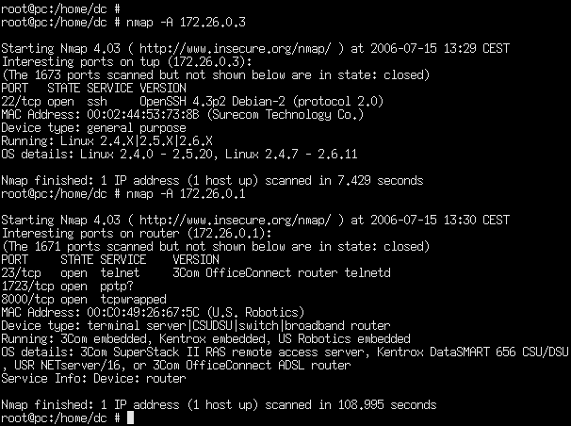
Nmap Command Usage Example
nmap -sP 192.168.2.1/24
This nmap command scans the local network, assuming common subnet masks and dhcp settings.
nmap –A 192.168.2.23
This scans a single host.
Notes:
The first Nmap command show here is a simple ping scan over an IP range. As it is an ICMP ping scan, other devices on the network can detect that they are being scanned.
This type of scan is visible on the network, that is it can be detected by the devices being scanned. Some devices may however not respond to ICMP requests, and an alternative scan is required to discover these ‘silent’ devices.
The second Nmap command shown scans all possible attributes of a single host, such as OS, hostname, and open ports. This is typically used after scanning the network and discovering all online devices. The target is then scanned thoroughly with the –A flag, potentially identifying its purpose on the network by using it’s OS type, although this is not always possible, for example a GNU/Linux system can be used as a server or a workstation/personal computer.

Slide 31
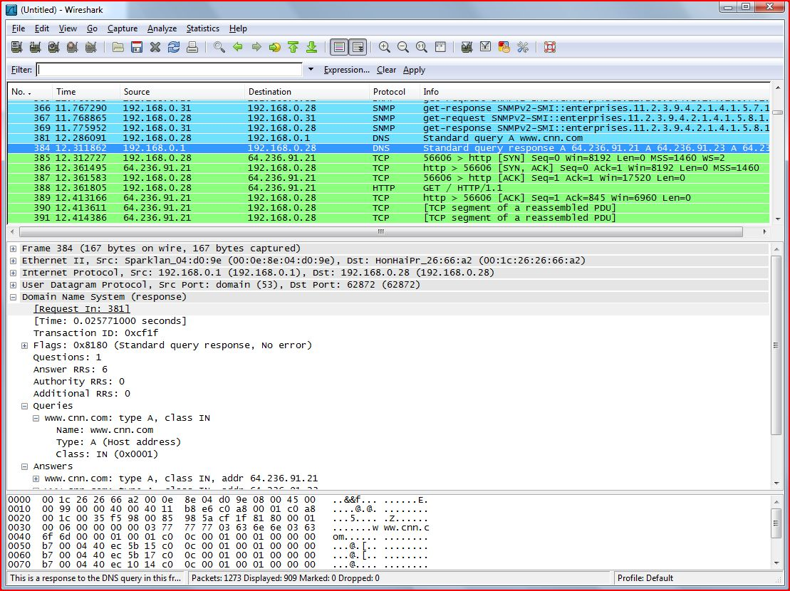
Wireshark in Use
Notes:
Here Wireshark is reading a previous capture file, where packets where captured and saved to a file. These are then loaded fromt the file and viewed by wiresharks GUI, as can be seen here. Wireshark highlights packets based on their type, and shows their destination and source IP addresses. Wireshark also understands packet contents for many protocols, and can display the content of them.

Slide 32
Network Mapping Example
A medium sized business runs an office for its accounting services.
The office was designed with modern design principles, and most staff use Wirelessly connected laptops and move around the offices frequently.
The office also features more static infrastructure, such as servers, firewalls, routers, databases and wired connectivity infrastructure.
The firm contracts a local IT company to install and configure a new group of servers and their required software.
The firm who installed all of the previous devices has been long closed and no engineers who installed the hardware are available for contact.
Notes:
Scenario is given above.
For this example a network enginner would have to identify which portiions of the network are the static wired ones, and which are the wirelessly connected devices using DHCP to assign IP addresses. In this firm all software runs on Apple OSX, so all wireless employee devices are easily distinguished. All servers run Linux, and network devices use systems varying from Ciscos IOS, simple embedded firmwares, and full stack Linux.
The Network Engineer could use nmap to scan the entire network, and visualize the layout with the nmap gui, zenmap. If this is not available, or does not work, simply identifying devices by their OS is a valid method. Once this is done and the network is mapped and understood the engineers can begin the process of installing and configuring the network devices, using this new knowledge of the network layout.

Slide 33
Emerging Technologies – P3

Slide 34
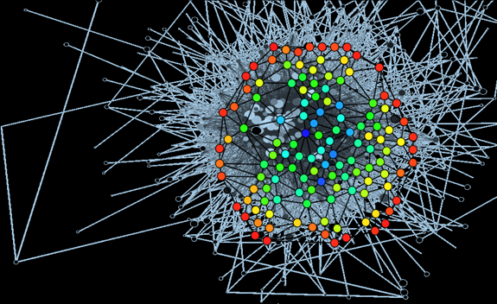
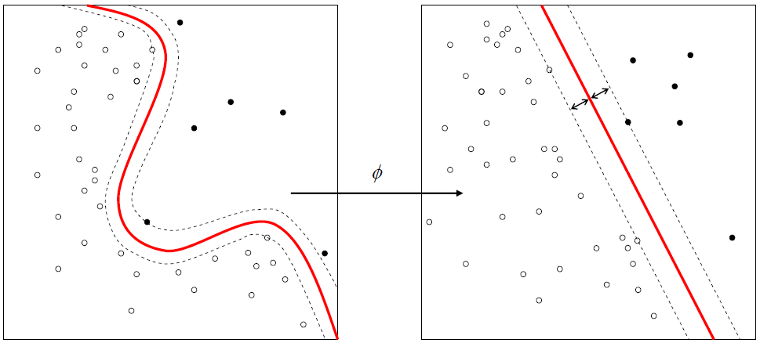
Machine Learning
Notes:
Machine Learning is the field of Mathematics and Computer Science that specializes in computer programs that learn from given data and then operate on further data using that ‘knowledge’.
During the 1960s Machine Learning was researched with the quest for AI at its height. There was, however, a lull during the 70s and 80s where general purpose AI was favored over Statistical Machine Learning. A resurgence during the 1990’s where General Purpose AI suffered an ‘AI Winter’, and the trend continues into the modern day, with new advancement’s in Machine Learning are increasingly common.
Machine Learning can have a huge impact on networking. With the addition of machine learning technologies, networks become much more adaptable and resilient. A network with machine learning support systems could adjust routing when nodes rearrange in a mesh network, based on previous results for network rearrangement.
As machine learning systems require data to train on, it can take a while before a learning network can correctly optimize, however when it does results can surpass those of algorithmic optimization.

Slide 35
Machine Learning Network Example
A business has a large Mesh network that scales kilometers of physical space.
The system may drop or acquire nodes at random, although no new unique nodes will be added to the network.
Several nodes, whilst on paper should not suffer delays, are suffering from routing delays an order of magnitude above others.
A regular routing system would not account for the added delay, and would route data through these nodes.
A learning and adaptive system would realize these nodes are slow, and route less data through these nodes, hence increasing the speed of the network.

Slide 36
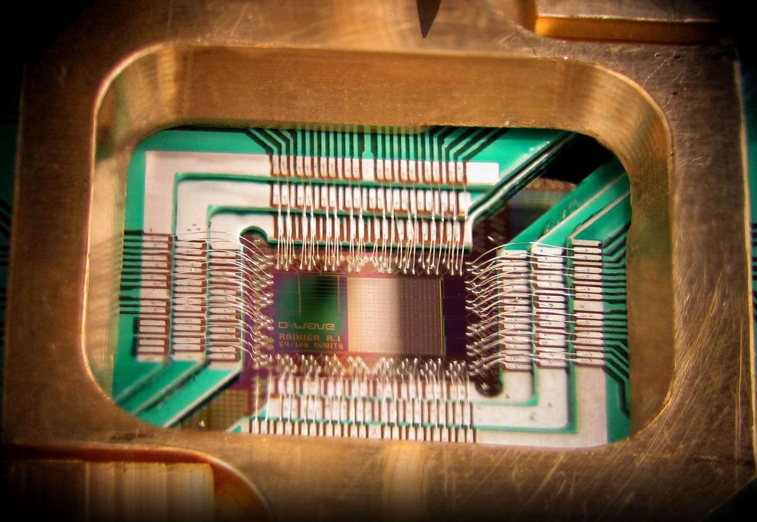
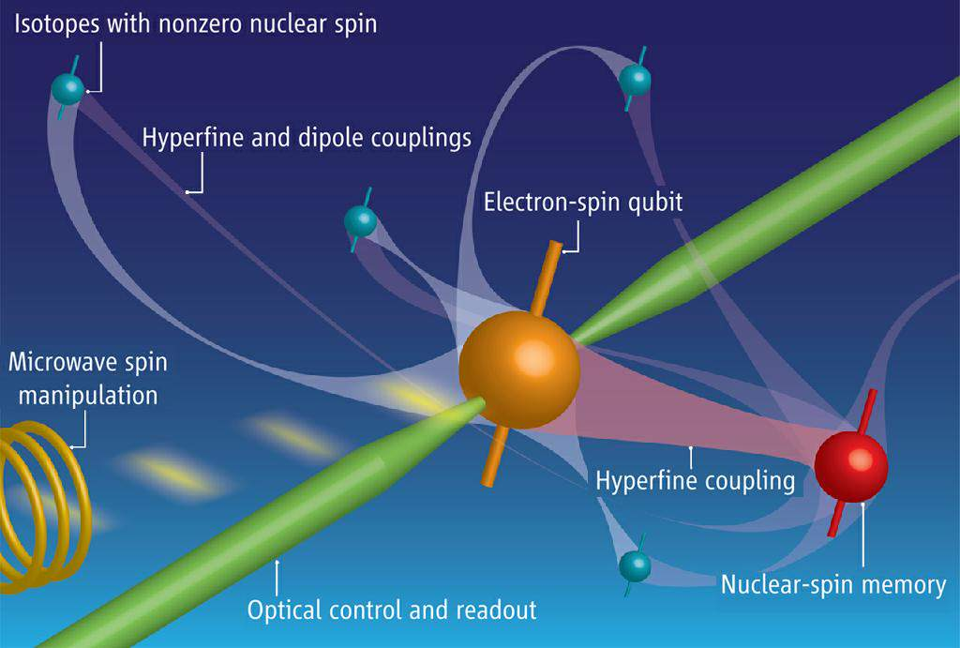
Quantum Computing
Quantum computing is a field that study’s computers that make use of quantum phenomena.
A quantum bit, or qubit can have two states at once, or in superposition.
Quantum Computers could perform calculations orders of magnitude faster than their classical counterparts.
Notes:
Research on quantum computing first began in the 1980s and while research still continues, quantum computing is still in its infancy.
D-Wave Systems Inc. demonstrated the Orion system, a prototype quantum computer, in 2007. Since then they have developed and released the D-Wave One, a business and research grade computer platform.
Quantum Computing could have a huge impact on networking, requiring new techniques to be employed by network designers to handle the large amount of information processed. While a quantum computer could communicate using a regular network, they can also communicate using quantum networks.
Quantum networks are concept for a network where the data exchanged stays in a quantum state, generally using fiber optic cables to send photons in different quantum states. This method allows for quantum computers to communicate in a more natural way. This would require new training and protocols in order to formalize quantum network standards.

Slide 37
Quantum Computing Example
A university has two quantum computers. One in the Computer Science department, and one across the courtyard in the mathematics and physics department.
Instead of networking conventionally the researchers want to create a quantum network.
For this a fiber optic cable is used, which photons in a quantum state are sent through. This requires less bandwidth than sending data over in a classical way as bits rather than qubits.
As quantum computing is still in its infancy no standard protocols exist for quantum networking, so in this scenario the networks physical layer, the fiber optic, is custom made with custom connectors. The protocol is also custom designed, to be optimal for transferring quantum data as opposed to classical.
Assuming further adoption of quantum computing and networks, a business with advanced calculation needs with several quantum computers could use quantum networks to exchange quantum data between their servers.

Slide 38
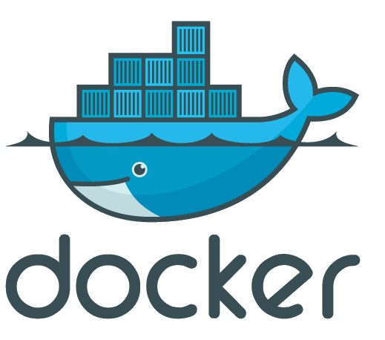
Containers and OS level Virtualization
OS Level Virtualization is a concept where a single instance of a kernel in an OS runs multiple user spaces.
Primarily used on Linux, containers have a huge range of applications in development, security and system administration.
Docker is a popular implementation of containerization that uses LXC.
Notes:
OS Level Virtualization was originally implemented in 1982 with unix’s chroot program. While without the plentiful features of current offerings, chroot was still powerful, and influenced containerization in the times to come. Nowadays docker dominates the containerization market, although it uses Linux Containers as a backend, a feature available since 2008.
In Linux, OS level virtualization a single kernel instance runs, with multiple so called ‘User Spaces’ on top. This means that no virtualization in the regular sense is ever used, as the hardware is just shared rather than simulated. Containers allow for increased security, as even with hundreds of instances on top of a kernel, no instance is able to interact with another, or even aware of other instances. Containers also allow limiting resource use on a per instance basis, limiting CPU time or RAM usage
Containers change networking massively. While new features such as compartmentalization of networking components like server processes changes the way security is handled, new problems are also faced. With what was once a single machine now making drastically more network requests, infrastructure may need to be redesigned.

Slide 39
Container’s Example
A company needs to deploy its own software to its clients running Linux. The clients run debian stable for servers, but the software requires features from many updated libraries that are present on the build platform (Fedora).
The software is distributed as source and built on clients platform. This is for performance reasons, among others.
While it is possible to build the new libraries and install them manually, this conflicts with the system package manager and introduces more room for error.
Instead, the company could set up a Docker powered Fedora build image, with all libraries and build tools preinstalled. Then a script could clone the program source, build it, install it and start the software.
As the whole system is run on a containerized Fedora image, there is very little overhead, but a clean system to build and run software on identical to the development system.

Slide 40
Conclusion
In conclusion, I will briefly highlight what I have outlined in this presentation and the included report.
Keep networks secure and safe, from hackers or errors. Use performance and fault management systems to keep systems efficient and safe. Watch emerging technologies for how they change the environment of networking, and keep up to date on these changes to make yourself a better candidate.

Slide 41
References
Wikipedia
http://industrial.embedded-computing.com/article-id/?4098=
http://www.smartreport.eu/network-monitoring/performance-management-it-network

